Slide 1
Code for Good 2017: Nobel Prize
Team 14
Andrei Nicolae, Daniel Barovbe, Joseph Sigbeku, Medardas Zobarskas, Ruben Dougall, Tom Schofield

Slide 2
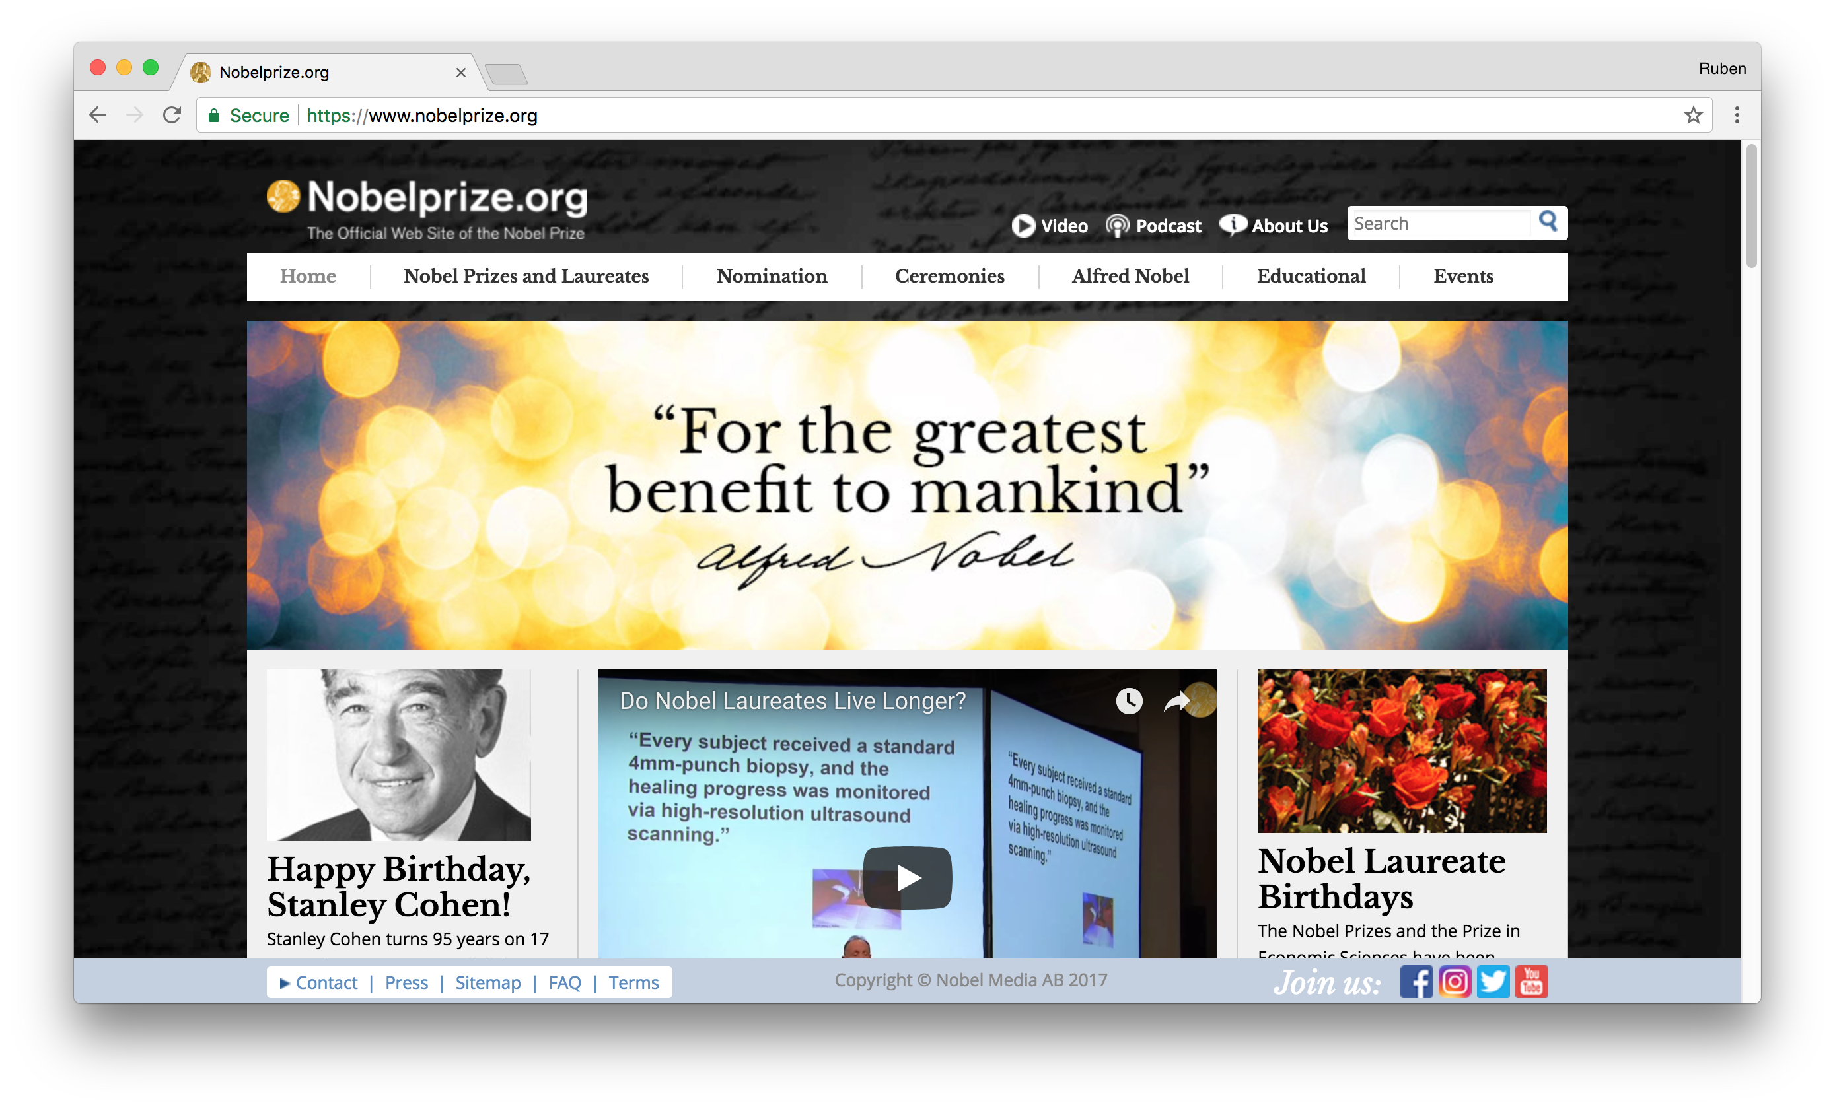
Current System

Slide 3
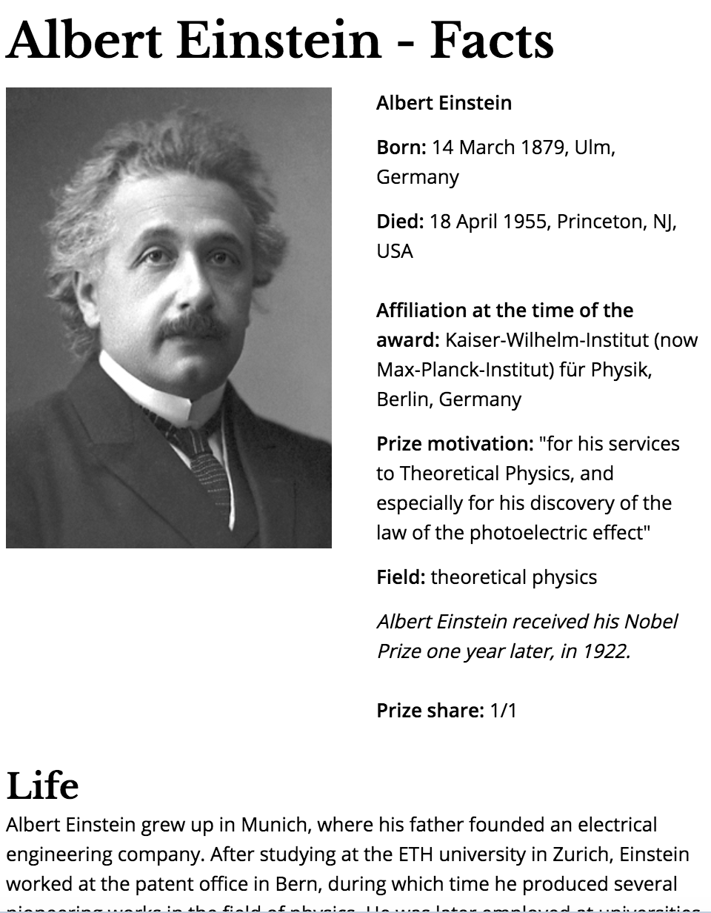
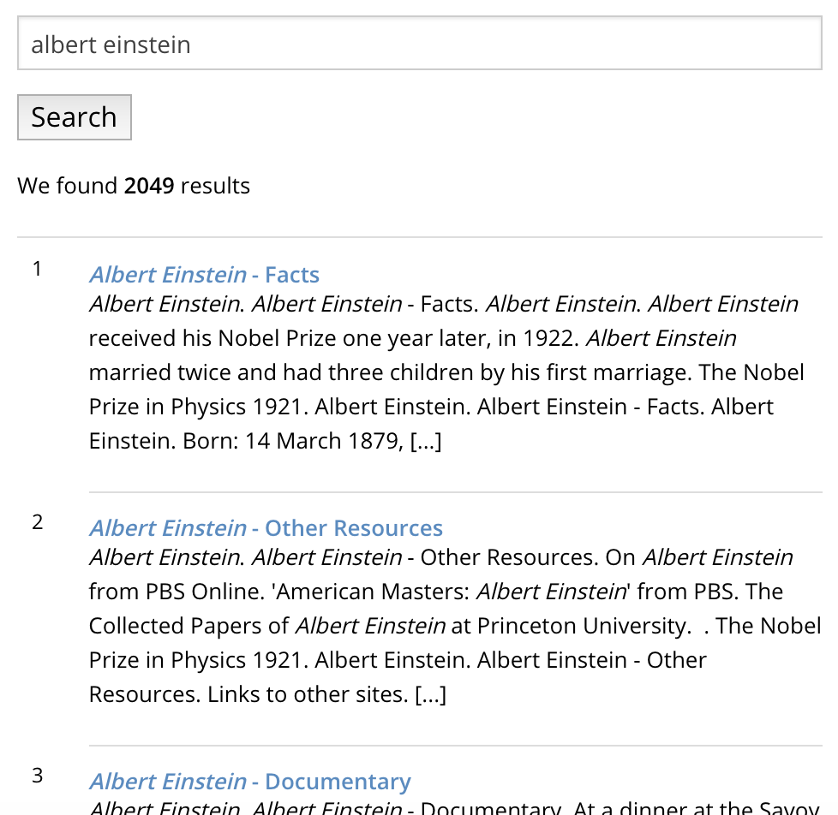
Current System
Quite extensive
Includes facts and biography for each laureate
Offers search function

Slide 4
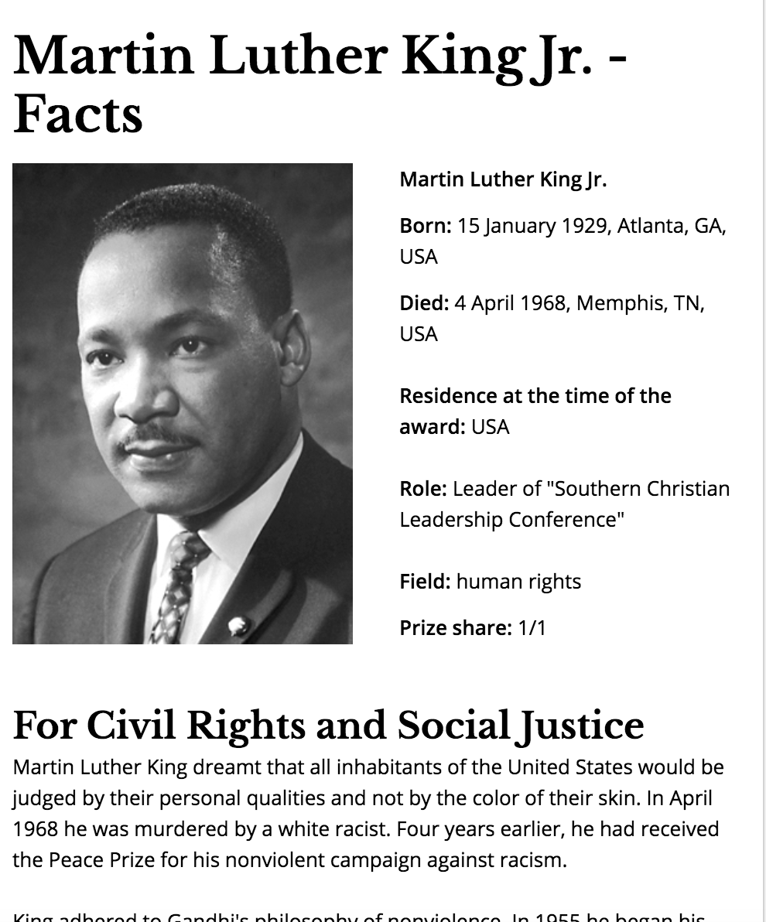
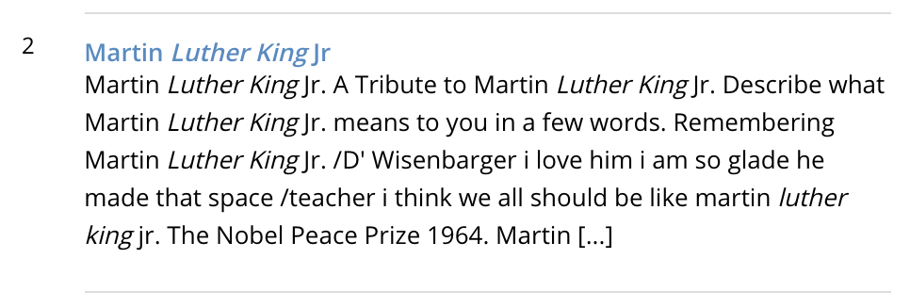
Limitations of Current System
User is restricted to a specific laureate
Search results are not very readable
Recommended topics are limited

Slide 5
Our System

Slide 6
Our System

Slide 7
Our System

Slide 8
Our System
Visually appealing to users
Much improved user experience; simple interaction with data
Allows visual exploration of content
Displays related topics and people in a comprehensible manner

Slide 9
Our System
Database
Natural language processing
Allows user to not know exactly what to search for
Essentially converts search term into API query
User interface
Easy-to-use; simple navigation
Provides a visual exploration in a tree format
Displays disciplines (e.g. physics, chemistry, peace), fields within these disciplines, and laureates within these fields

Slide 10
Technologies
Back-end
Initially used Django with our own database
Later instead used PHP and queried using Nobel’s API directly
Used REST and linked data (SPARQL) APIs
Originally divided into database and natural language processing sections
Front-end
Paper.js on top of HTML5 Canvas

Slide 11
Next Steps
Finish and make production-ready
Make mobile-friendly
Utilise all of the available data
More suggestions
Add “achievements”

